Slide 1
Cloud Computing
SEWP ZG527

Slide 2
Cloud Infrastructure Management using OpenNebula

Slide 3





Cloud ? That looks easy!!!
Is it So?????
Notes:
RL 6.1

Slide 4
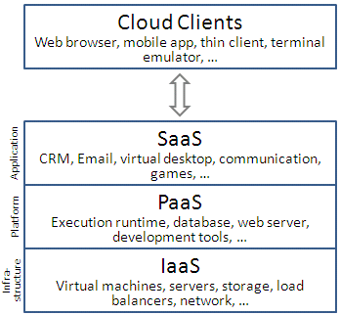
Introduction
So CLOUD requires managing……
But what will you manage

Slide 5
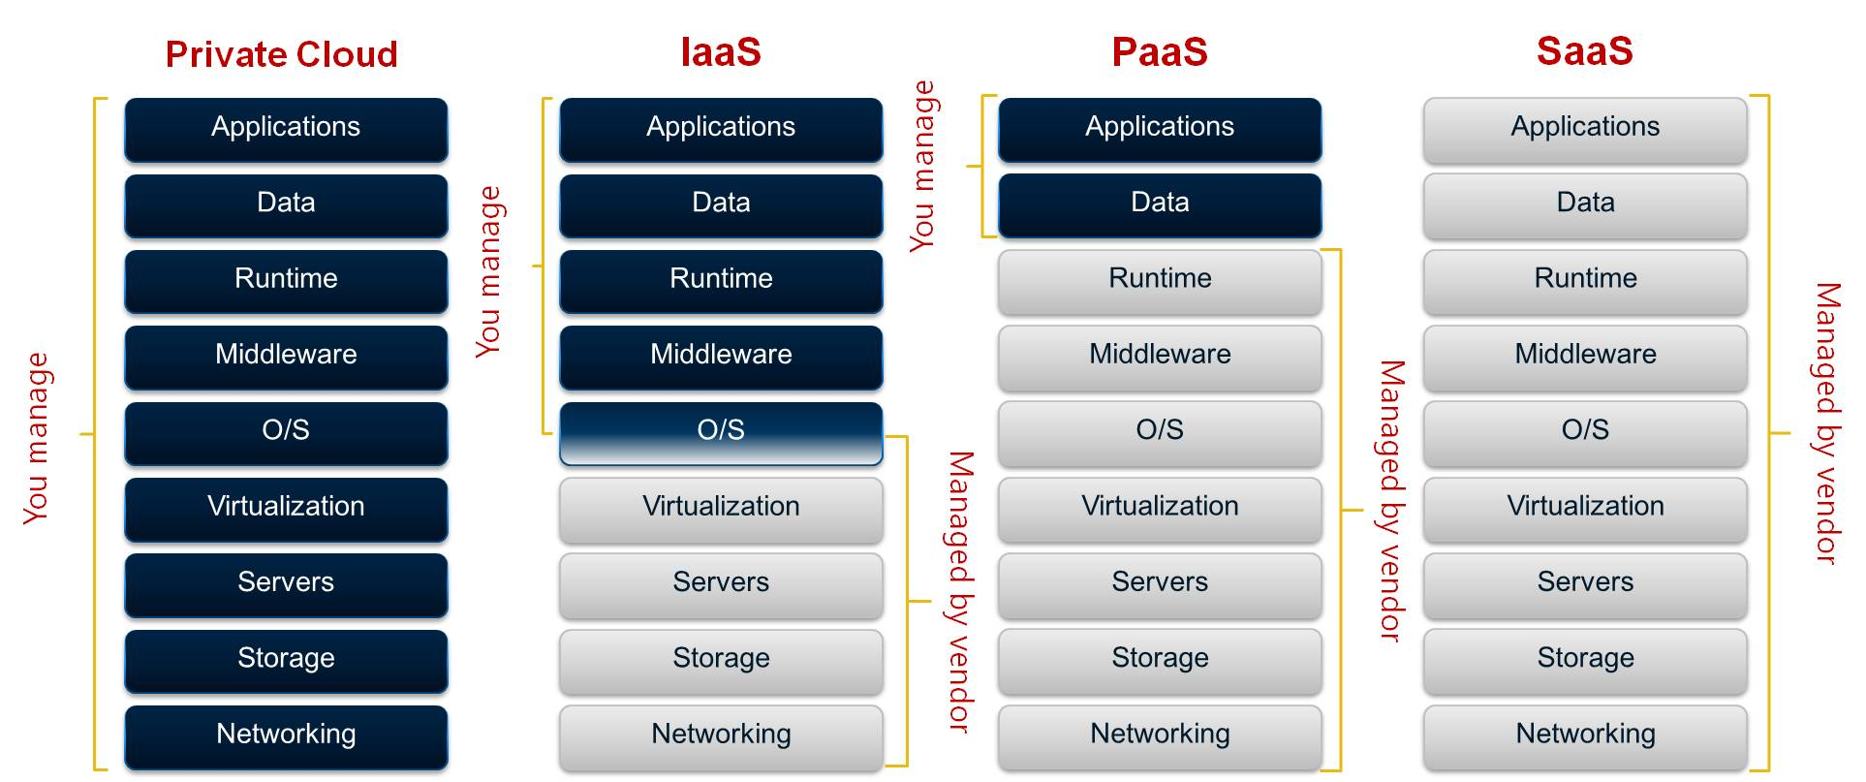
Introduction
Ok, ok got to know what to manage…..
Is it so………..????

Slide 6
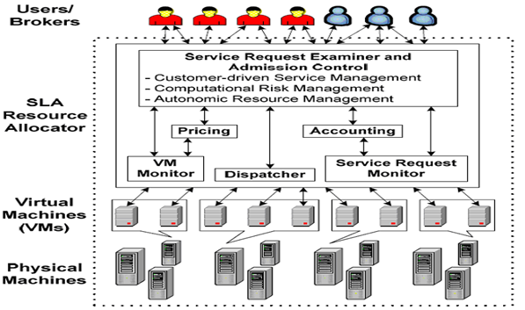
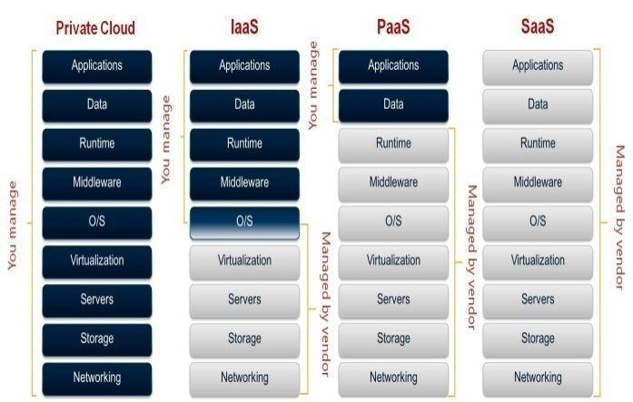
OMG!!!!
Therefore the key requirement
for cloud architecture is
“efficient management”
of resources at all the
three layers of cloud stack

Slide 7
Cloud Distributed environment
With large scale of systems to manage
Support of multi-tenancy
Management to maintain SLAs
So there is need for automation to replace manual operations and to reduce overall cost

Slide 8
Outline
Virtual infrastructure managers
Architectural view on OpenNebula
Constructing a Private cloud
Virtual Machines in OpenNebula
Constructing a Hybrid cloud

